Slide 1
Multivariate Design of Experiments for Engineering Dimensional Analysis
Chris Nachtsheim
Carlson School of Management and
School of Statistics
University of Minnesota
Daniel J Eck
Department of Statistics
University of Illinois
Thomas A Albrecht
Atlassian
FTC Webinar Series, November 3, 2021

Slide 2

Joint Work With:
Dennis Cook: University of Minnesota

Slide 3
Outline of Talk:
Basic ideas of DA
Address dimensional analysis for multivariate responses
Examples
A glimpse at optimal design techniques for this problem
How we got involved in dimensional analysis
Conclusions

Slide 4

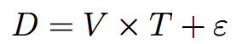
Statistics vs. Engineers: A simple example
We wish to characterize the effects of velocity (X1) and time (X2) on the response variable distance, D.
Now, we’re ignorant, but an oracle knows that the true relationship is:
How do we figure this out?

Slide 5
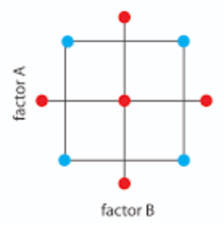

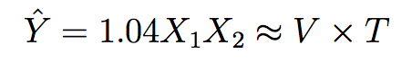
Statistician’s approach
DOE!!! We’re concerned about curvatures and interactions, so run a central composite response surface design!
After running the experiment, fit the second-order model:
Drop out non-significant terms,

Slide 6
Statistician’s approach
DOE! We’re concerned about curvatures and interactions, so run a central composite response surface design!
After running the experiment, fit the second-order model:
Drop out non-significant terms,

Slide 7
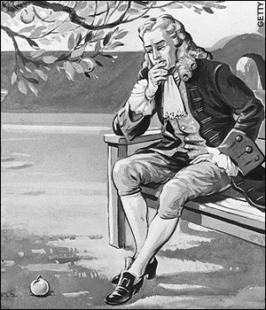
Engineer’s approach
The Engineer thinks more like Isaac Newton in that the mechanics of a physical systems are governed by physical laws
A physical equation must be dimensionally homogenous
D = h(V,T)
[D]=Miles
[h(V,T)]=Miles

Slide 8
Engineer’s approach
Dimensions (Units) of the variables:
[D]=Miles
[V]=Miles/Hour
[T]=Hour
One dimensionally homogeneous possibility:
Dimensionally Homogenous
D = cVT

Slide 9
Engineer’s approach
One Final Simplification: We make the equation dimensionless by dividing both sides by VT.
To estimate c, all we need to do is pick a velocity, V, pick a time, T, observe D and plug in (replicate as needed).
Dimensionless Representation

Slide 10
Statistical vs. Engineering Approaches
 | Statistician’s Approach | Engineer’s Approach
Factors to vary in experiment | Two (Time, Distance) | Zero (one fixed constant)
Model parameters | 6 parameters | One fixed constant
Scalability | Model valid inside experimental range of factors | Will “scale” over any experimental range
Explanatory Power | Local, empirical model | Reveals a “universal law” between D,V, & T for physical systems

Slide 11
Dimensional Analysis (DA) Advantages
Dimension reduction ✔
The number of factors is reduced by the number of measurement dimensions in the variables
Our example: Number of factors = 2. Number of dimensions is 2 (length, time). Resulting number of dimensions is zero!
Scalability ✔
Empirical models are valid within the ranges of the factors
Dimensionless models scale to any size

Slide 12
Why is scalability important?

Slide 13
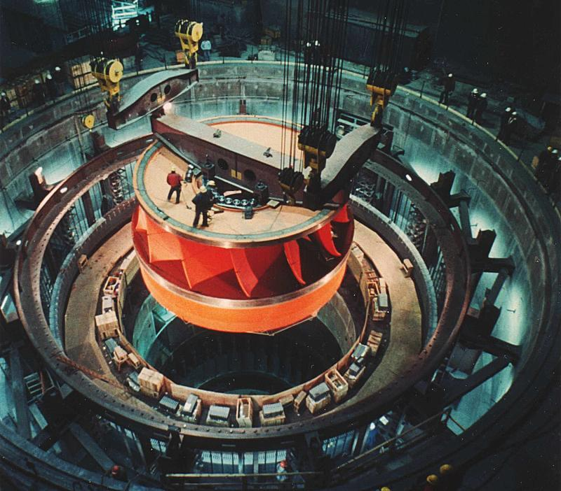
Running experiments on a turbine of this size is impossible

Slide 14
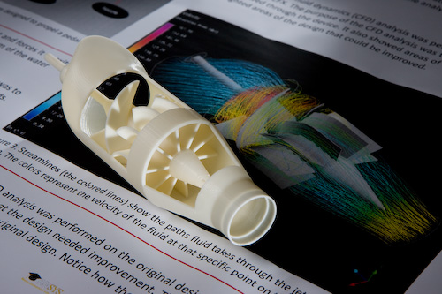
Running experiments on a model of this size is easy. If all variables are dimensionless, we can extrapolate!

Slide 15
An even more compelling type of extrapolation…

Slide 16


Slide 17
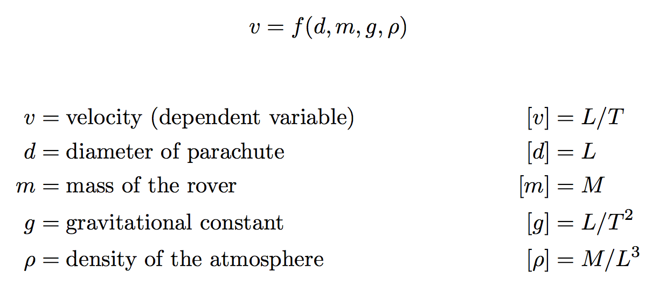
Mars Rover DA Process
Notes:
Talk about gamma, poisson’s ratio. It is a variable that describes a material property of rubber. Its “Stretch to Compression.” An engineer has already got their hand into the cookie jar here. This number is a dimensionless quantity

Slide 18
Ipsen (1960) Stepwise Derivation of DA Model
Step-by-step approach that leads to dimensionless DA model
At each step, one variable is used to eliminate a dimension (e.g., M, L, T) from the set of variables.
The variable used is eliminated
At termination, a reduced set of dimensionless variables is created

Slide 19
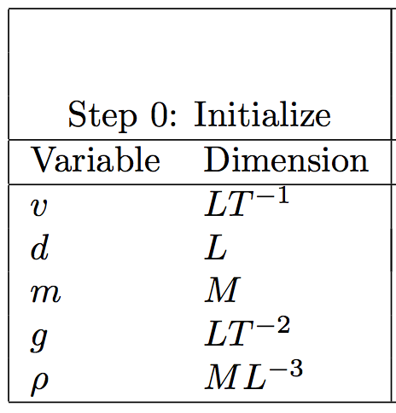
Step 0: Initialize the variables by specifying dimensions

Slide 20
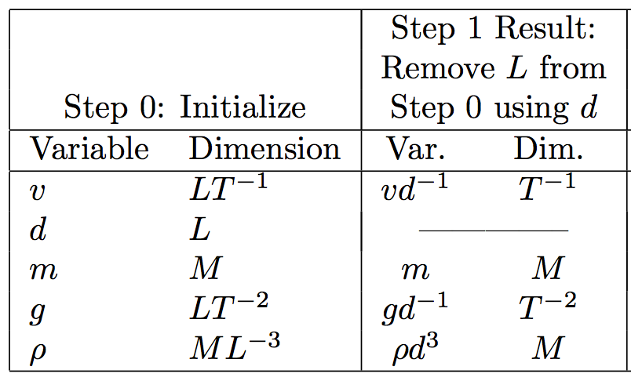
Step 1: Use d to eliminate length (L)

Slide 21
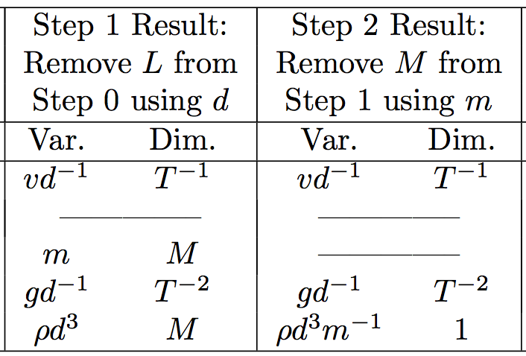
Step 2: Use m (rover mass) to eliminate mass (M)

Slide 22
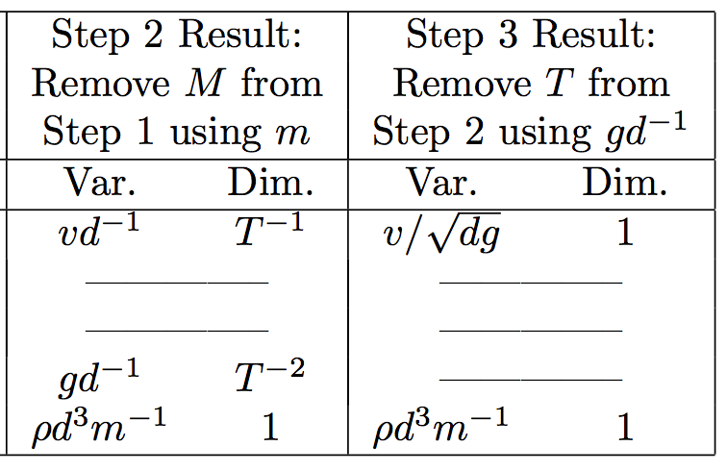
Step 3: Use gd⁻¹ to eliminate time (T)

Slide 23
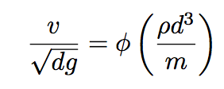
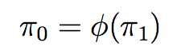
Result
DA model:
DA terminology: two dimensionless variables or “pi groups”

Slide 24
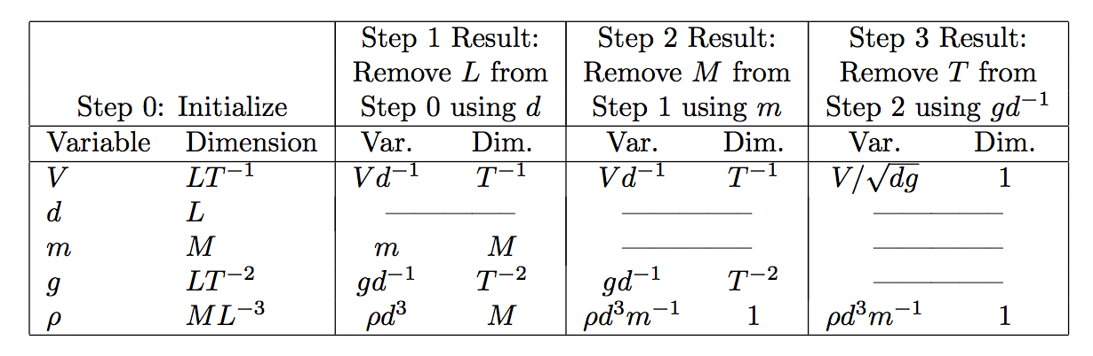
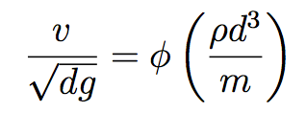
Summary

Slide 25
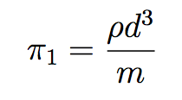
So we have a one-factor DA experiment
Model:
Objective: Estimate φ by varying the single factor π₁:
On Earth, cannot vary ρ = density of atmosphere.
Could vary m = mass of rover but no need.
Just vary d in order to vary π₁

Slide 26
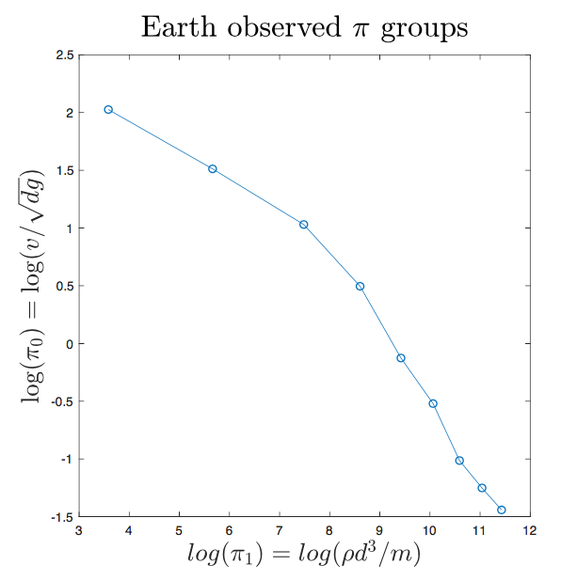
(Logged) Earth-bound results, n = 9

Slide 27
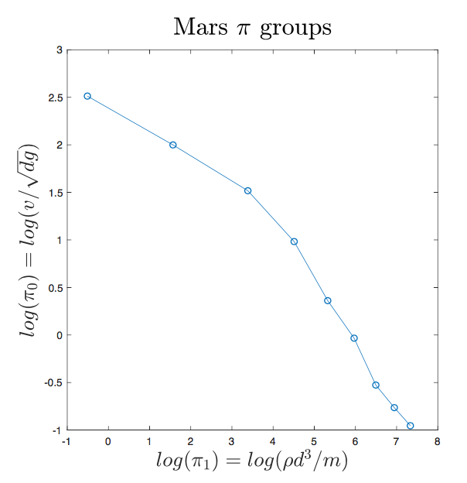
OK: But what about Mars?
Just change the gravitational constant and the atmospheric density, and re-compute the π groups:

Slide 28
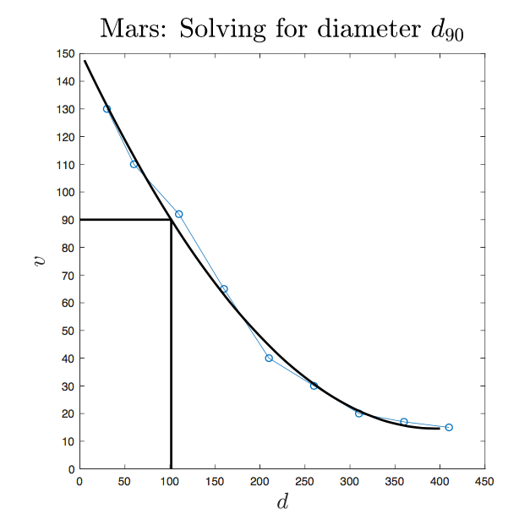
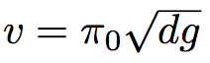
Now solve for v, smooth, and back-solve for d₉₀
The diameter that slows the rover to 90 m/s is 101 meters

Slide 29
Power of DA
Example shows:
Not only can we extrapolate outside the range of the experimental region
We can understand the effects of changing physical constants without actually changing them
Run an experiment on Earth, extrapolate to Mars

Slide 30
How do we know this process works?

Slide 31
How do we know this process works?
Buckingham Π Theorem (1914)
If there is a physically meaningful equation involving a certain number n of physical variables, then the original equation can be rewritten in terms of a set of p = n − k dimensionless parameters π₁, π₂, ..., π_{p} constructed from the original variables, where k is the number of physical dimensions involved.
First proven by Joseph Bertrand (1878), in context of electrodynamics

Slide 32
Contributions of new paper
MV Buckingham Π Theorem
New multivariate design criteria
Illustrations: one simple, textbook example, one very complicated example
Recommendations for optimal design algorithms in complicated situations
(Maybe) a better introduction to DA for statisticians

Slide 33
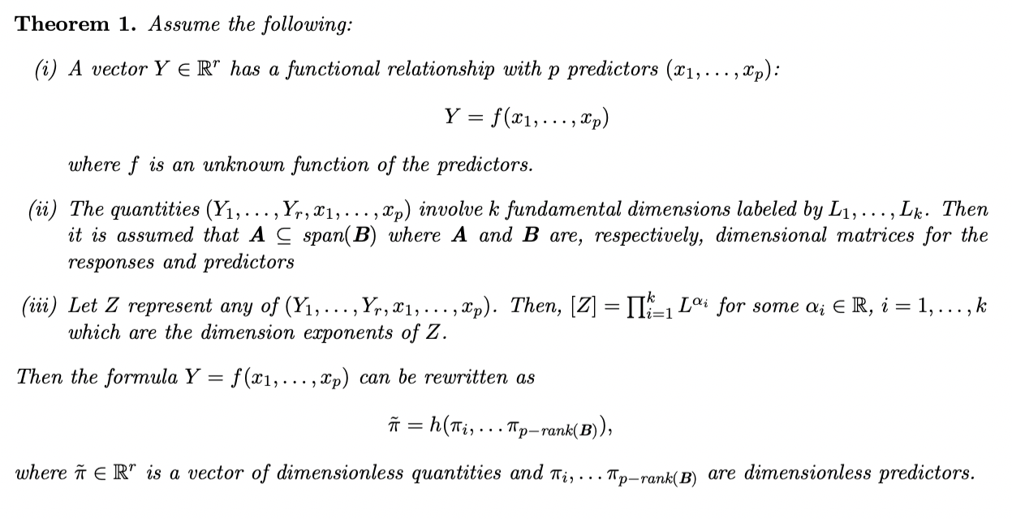
MV Buckingham Π Theorem

Slide 34
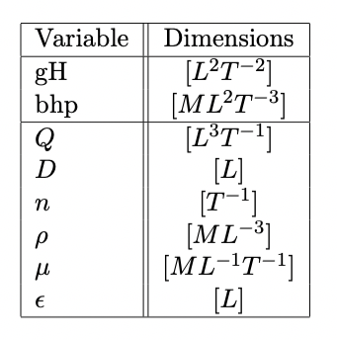
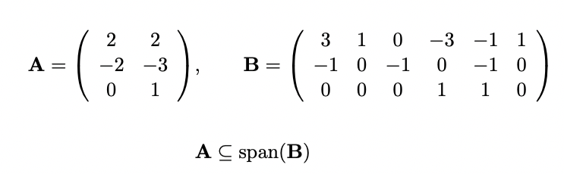
Simple Example (White, Fluid Mechanics, 2008)
Pump design. Outputs are head pressure (gH) and brake horsepower (bhp)
Predictors: Q, D, n, μ, ρ (ε not considered)

Slide 35
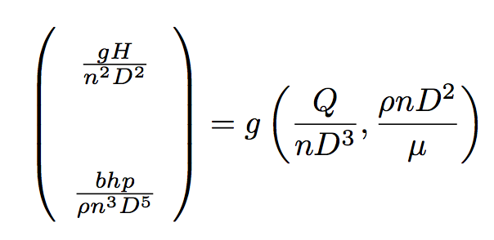
Simple Example (White, Fluid Mechanics, 2008)
DA model (two response π’s; 2 factor π’s):
Only Q, n, and D are varied, μ and ρ are held constant.

Slide 36


There are two design spaces
Design space in the original variables, Q, n, and d:
Design space in the two pi groups:

Slide 37
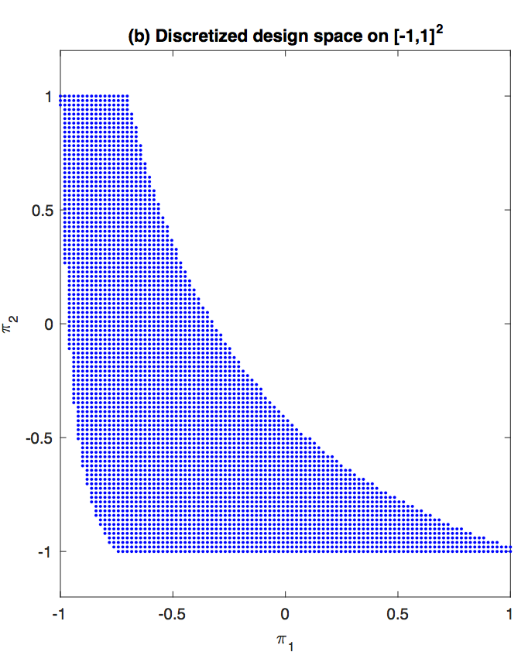
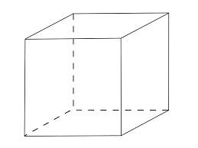
Pictures of Design Spaces
χ
χ_{π}

Slide 38
Design Recommendations
Previous work we recommended use of:
Nonparametric designs
Uniform designs
Minimax distance designs (etc.,)
Parametric designs
D-optimal designs for 3rd-order (or higher-order) models
Suggested I-optimal, L-optimal* designs as alternatives
_
*Cook, Nachtsheim “Model Robust Linear-Optimal Designs, Tech, 1983

Slide 39
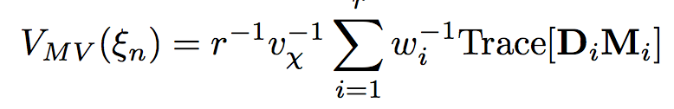
MV I-optimality
The MV I-optimality criterion:
The MV criterion is simply the model-robust, L-optimality criterion of Cook and Nachtsheim (1982, Technometrics), where the weights are given by the variances, w_{i}⁻¹.

Slide 40
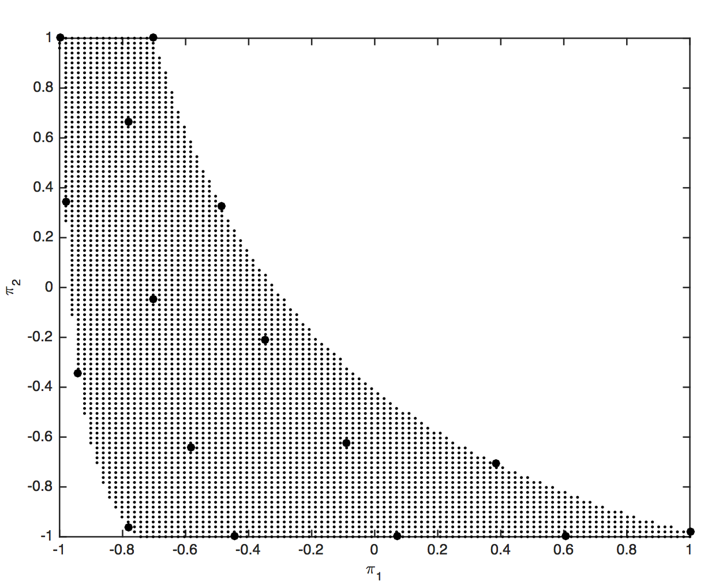
I-Optimal Design (n = 16)

Slide 41
Heat exchanger example

Slide 42
A more complex example
Design of a heat exchanger with bivariate response
Response 1 is the pressure loss (ΔP)
Response 2 is heat transfer rate (Q)
There are 9 independent variables (next slides)
There are four fundamental dimensions: L, M, T, and t
Thus there will be 9 - 4 = 5 independent pi groups

Slide 43
Schematic

Slide 44
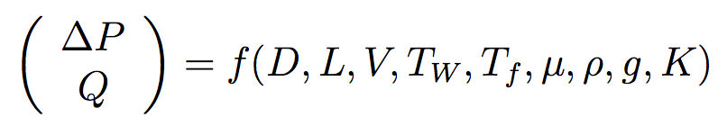

Slide 45
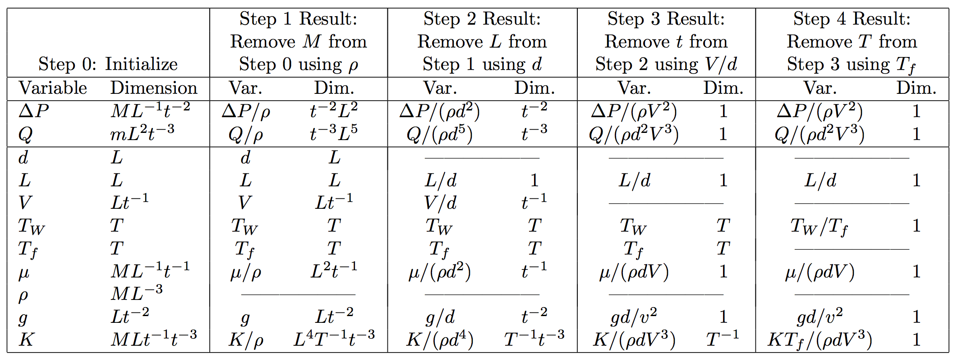
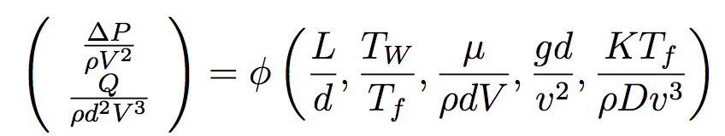
Derivation of DA Model

Slide 46
Derivation of DA Model
Reynold’s number
Euler’s number

Slide 47
Design Generation Findings
Parametric design
Generate the designs using the 8-dimensional original variables space
Use coordinate exchange with continuous optimizer for each coordinate
Nonparametric design
Generate 100K uniformly distributed points in the 5D Pi design space for use as candidate set
Use candidate set with Fast Flexible Filling* to create designs
*Ryan Lekivetz, Brad Jones, QREI, 2014

Slide 48
Parametric Design: 2D Projections, n = 100

Slide 49
Nonparametric Design: 2D Projections, n = 100

Slide 50
Comments/Conclusions
DA is a powerful tool for modeling physical systems
Parsimony, Scalability, Dimension Reduction
Multivariate responses not uncommon
Gave generalization of Buckingham for multivariate responses
Gave new criterion of multivariate parametric design
Gave recommendations for design construction

Slide 51
History of DA in stats as told by Chris

Slide 52
How did we statisticians get involved in DA?
(c. 1980) Chris’s early consulting– giving bad advice
1988 talk on DOE at Carlson school to Mgt Sci department
2011, Tom Albrecht, Boston Scientific
2013, M. Albrecht, Nachtsheim, Cook, T. Albrecht, Experimental Design for Engineering Dimensional Analysis, Technometrics
2014-, Dennis KJ Lin and his students
2021, our paper

Slide 53
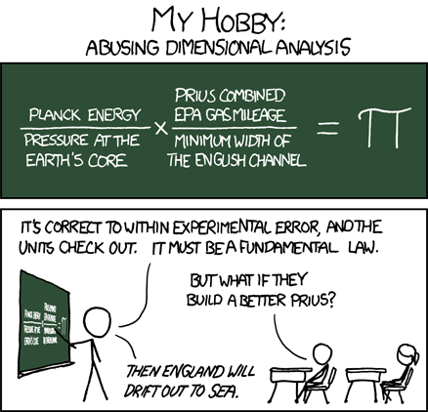
Thank you

